Slide 1
Consciousness

Slide 2
I. Sleep & Dreams
Percentage Who Report Having Had These Dreams Men Women
1 Chased or pursued 78% 83%
2 Sexual experiences 85% 73%
3 Falling 73% 74%
4 School, teachers 57% 71%
5 Arriving too late 55% 62%
6 On the verge of falling 53% 60%
7 Trying to do something 55% 53% repeatedly
8 A person living as dead 43% 59%
9 Flying or soaring 58% 44%
10 Sensing a presence vividly 44% 50%
11 Failing a test 37% 48%
12 Being physically attacked 40% 44%
13 Being frozen w/fright 32% 44%
14 A person now dead as living 37% 39%
15 Being a child again 33% 38%
4. DREAMS
DREAMS
sequence of images, emotions, & thoughts passing through a sleeping person’s mind.
Notes:
We call the mental activity that takes placed during sleep dreaming. Everybody dreams, although most people are able to recall only a few, if any of their dreams.
When researchers learned their was a link between REM sleep and dreams they no longer had to rely on someone’s hazy memory hours or days after having a dream, researchers could catch dreams as they happened. They could awaken people during or within 3 minutes after a REM sleep period and hear a vivid account.
The first few dreams are usually composed of vague thoughts left over from the day’s activities. A participant may report that she was watching television, for example. As the nigh moves on, dreams become longer and more vivid and dramatic, especially dreams that take place during REM sleep. Because the amounts of time spent in REM sleep increases during the night, the last dream is likely to be the longest and the one people remember when they wake up.
We spend 6 years of our life in dreams, many of which are anything but sweet. For both women and men, 8 in 10 dreams are marked by at least one negative event or emotion. Here are some common themes when dreaming. Click for chart

Slide 3
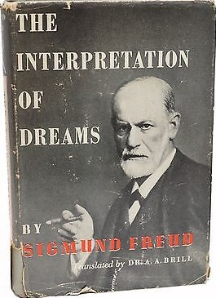
I. Sleep & Dreams
4. DREAMS
Why We Dream
1. Psychodynamic Theory (Freud)
Dreams are our unconscious urges, wishes
Manifest Content - Dream’s story line
Latent Content - underlining meaning of dreams
- scientifically debunked
Notes:
Here are four theories why we dream. The first theory came to us from Sigmund Freud in his 1900 book, The Interpretation of Dreams. Sigmund Freud proposed that dreams provide a psychic safety valve that discharges otherwise unacceptable feelings. He viewed a dream’s story line(manifest content) as a censored, symbolic version of its latent content (the unconscious drives and wishes) that would be threatening if expressed directly. Freud nevertheless believed that most adult dreams could be “traced back by analysis to erotic wishes.” Thus, a gun might be a disguised representation of a male’s genitalia.
Debunked: Based on the accumulated science, “there is no reason to believe any of Freud’s specific claims about dreams and their purposes,” observed dream researcher William Domhoff. Some contend that even if dreams are symbolic, they could be interpreted any way one wished. Others maintain that dreams hide nothing. A dream about a gun is a dream about a gun.

Slide 4
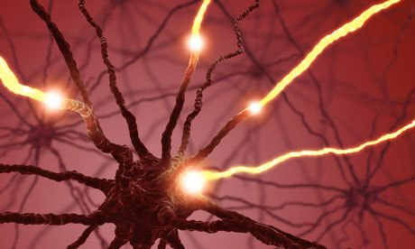
I. Sleep & Dreams
4. DREAMS
Why We Dream
2. Neural Activation
REM sleep triggers neural activity that evokes random visual hallucinations, & emotions that our brain weaves into stories
Notes:
Neural activation
Dreams erupt from random neural activity spreading upward from the brainstem. Dreams are the brain’s attempt to make sense of random neural activity. Neurosurgeons can produce hallucinations by stimulating different parts of a person’s cortex. So random neural stimulation can do the same thing.
These internal stimuli activate brain areas that process visual images. PET scans of sleeping people also reveal increased activity in the emotion-related limbic system (in the amygdala) during REM sleep. The limbic system in charge of our emotions are also stimulated, given us the emotion in our dreams. The Frontal lobe that is responsible for inhibition and logical thinking does not receive any stimulation. This may explain why our dreams are less inhibited than we are when awake. This also may explain Freud’s theory where our dreams illustrate our unconscious wishes and urges.

Slide 5
I. Sleep & Dreams
4. DREAMS
Why We Dream
FAST FACT
3. Information-processing
Dreams help us sort out the day’s events & consolidate our memories
4. Physiological Function
Brain stimulation from REM sleep helps develop & preserve neural pathways
Secondary students with high grades have averaged 25 minutes more sleep a night than their lower-achieving classmates
Notes:
The information-processing perspective proposes that dreams may help sift, sort, and fix the day’s experiences in our memory. In an experiment, people were tested the day after learning a task. Those who had been deprived of both slow-wave and REM sleep did not do as well as those who had slept undisturbed on their new learning. In other studies, people who heard unusual phrases or learned to find hidden visual images before bedtime remembered less the next morning if they had been awakened every time they began REM sleep than if awakened during other sleep stages.
Physiological Function: Perhaps dreams, or the brain activity associated with REM sleep, serve a physiological function, providing the sleeping brain with periodic stimulation. Instead of the brain remaining dormant for 8 hours a day for our lives, it is still working, learning, reinforcing and expanding our knowledge

